Slide 1


Emerging Trends & Campaigns
Reading Time 3/5-minutes

Slide 2
Contents
Emerging Trends
Campaigns

Slide 3
Dentist Scams
Watch out for communication from Dental Practices.
Texts received from criminals pretending to represent Dental Services.
Requesting personal details from victims.
Offering new NHS capability.
Always contact dental practice by contact details known to be genuine. Look on website or in practice.
Emerging Trends
Refund Requests
Beware when selling or receiving bookings. Confirmed Fraud incidents with victims in the North-East. The criminal buys item/s or pays a deposit on a booking. They then requests a refund. The refund will be stolen by the buyer/criminal. The initial payment will be refused some time afterwards.
Council Tax
Be cautious with communications received from what looks like your Local Authority, requesting Council Tax payment. Criminals have sent messages out in the North-East in the past week encouraging customers to follow a link and pay money.
Always contact your Local Authority using details know to be genuine. Look on the website or in a Local Authority building.

Slide 4
Campaigns
Report Fraud:
The new name for Action Fraud
This is where we now report Fraud & Cyber Crime in the UK
www.reportfraud.police.uk
0300 123 2040

Slide 5

Tell the Police about Cyber Crime and Fraud
www.reportfraud.police.uk or call 0300 123 2040
Report Fraud has replaced Action Fraud, for use in England, Wales and Northern Ireland.
Anyone searching for how to report cyber crime or fraud, or trying to use Action Fraud, will, from 4 December 2025, be redirected to the new service, which can be reached directly online at reportfraud.police.uk or by calling 0300 123 2040.
Report Fraud will provide:
A clear and simple reporting process to tell the police about cyber crime and fraud
Guidance on what to report and how that information is used
Further support information for victims
OFFICIAL November 2025 NEROCU

Slide 6
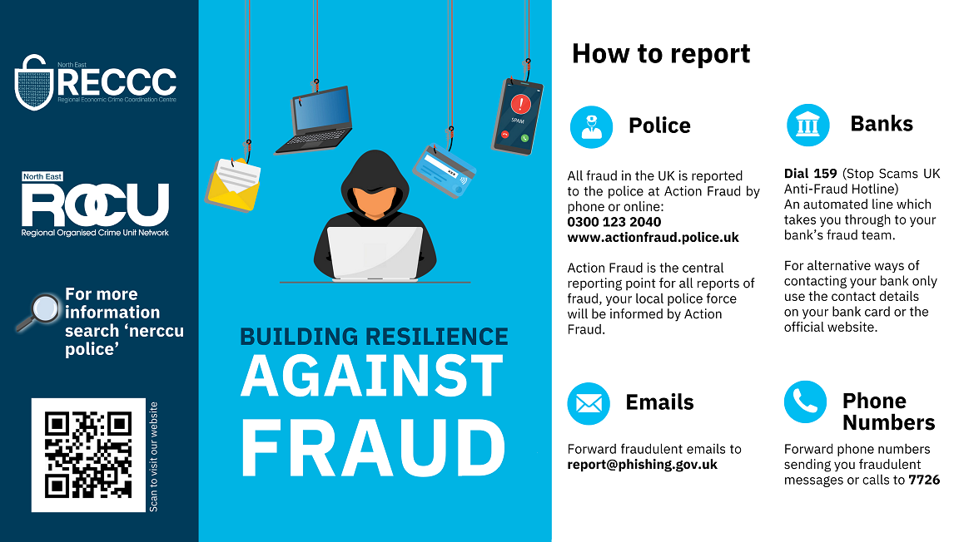

Every Report Counts
All Fraud in the UK is reported to the police at Report Fraud by phone or online:
www.reportfraud.police.uk
0300 123 2040
Report Fraud is the central reporting point for all reports of fraud, your local police force will be informed by Report Fraud
Dial 159 (Stop Scams UK
Anti-Fraud Hotline)
An automated line which
Takes you through to your
Bank’s Fraud team .
Fraud in the UK is reported
Forward Fraudulent emails to
Forward phone numbers
Sending you Fraudulent
Messages or calls to 7726

